Slide 1
Recreational Chair
Cullen LaKemper, Kurtis Bowen, Matthew Payne

Slide 2
Member #1
Matthew Payne:
I’m a 15 year old sophomore from Columbia, SC attending Spring Valley High School. I enjoy playing sports and plan to be an engineer in the future.

Slide 3
Member #2

Slide 4
Member #3

Slide 5
Team Norms
Alway be kind to team member (no foul language or insults)
Any criticism should be constructive and trying to help your team member
Attempt to contact other members when in class
Provide input and help for all group assignments

Slide 6
Problem
Consumers have to purchase different chairs in order to partake in multiple recreational activities, making it costly and creating storage problems when not used.

Slide 7
Design Challenge
Design, build, test, and present a multi-use portable chair designed to allow a person to use it in a stadium, at the beach, or park. This design should be tested and approved by the majority of a random sampling of consumers.

Slide 8
Design Constraints
Holds a least 3 different items
Support 2 different functions (eating, reading, etc)
Available in multiple colors
Easy to clean
Easy to transport
Must be affordable

Slide 9
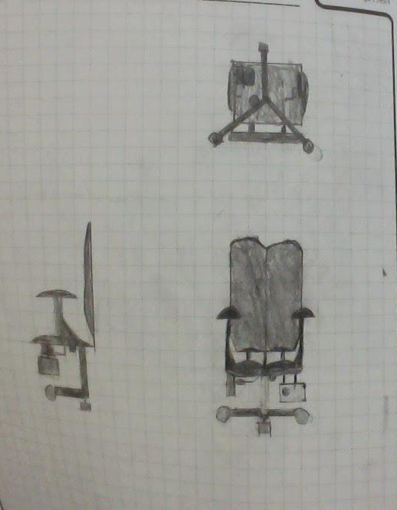
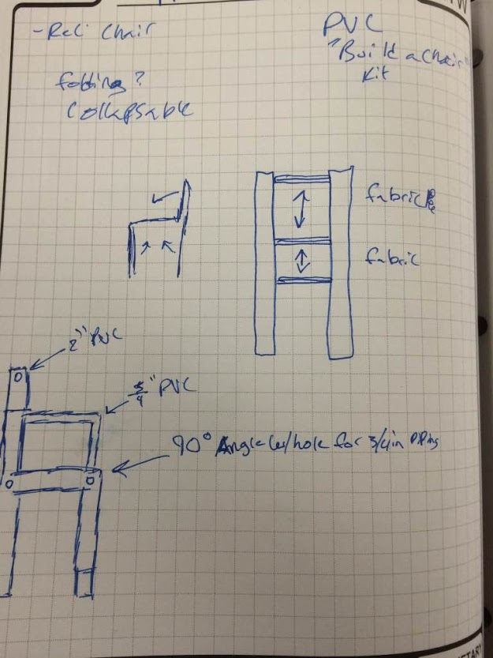
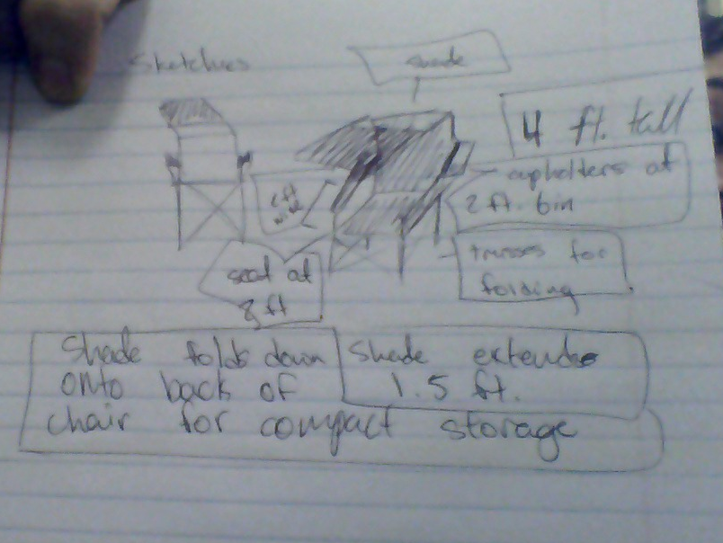
Initial Sketches
My chair was designed for maximum comfort including padding lots of reclining options and a mini fridge
My chair was designed to hold drinks and to shade a person to offer maximum comfort

Slide 10
Reason for our selection
We thought a simple PVC pipe would be the best solution to making a chair that could be used for many recreational purposes while maintaining maximum comfort and portability. The lightweight frame which can be taken apart allows for easy movement anywhere and storage in cars and other transportation methods. While the PVC can be snapped back together with ease.

Slide 11
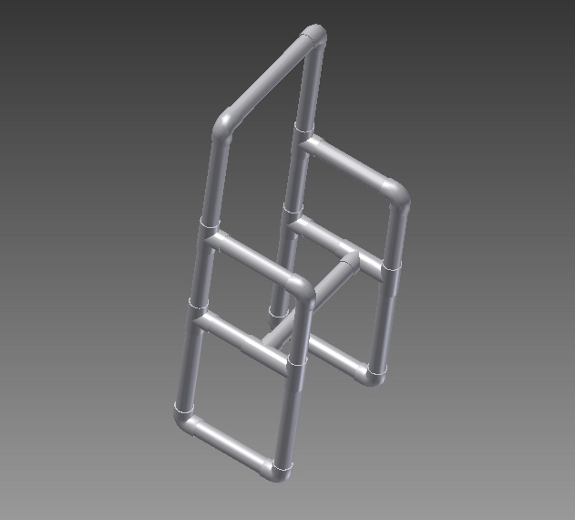
Initial CAD Drawing
This initial drawing was selected
as a frame for the chair.
We feel that this is a good start
for the chair in order to build
a solid frame support.
The required features will be
added to the final design.

Slide 12
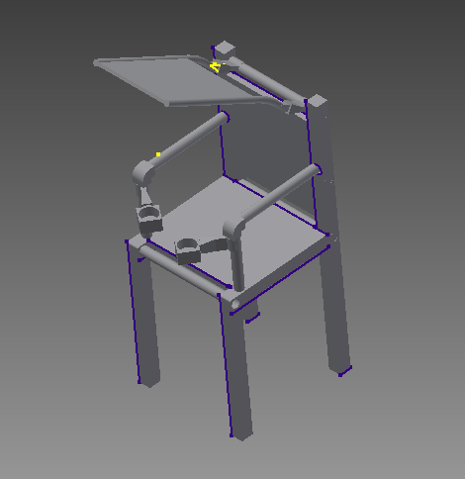
Design
-This design is made of PVC pipe
so its light enough for most people
to carry.
-This increases market
appeal and makes it affordable.
-It offers a shade and cup holders.
-The PVC pipe is sturdy enough
for most people to use.

Slide 13
Bill of Materials
PVC Pipe- light, easy for assembly and disassembly, cheap.
Fabric- light weight, cheap, comfortable, easily taken on and off of the frame.

